Slide 1

INCOME EQUITY HUB

Slide 2


ABOUT US
We are a team of Data Scientists specializing in statistical analysis, machine learning, and data visualization.
Our goal is to uncover intricate patterns and trends within the broad scope of socioeconomic data, with a focus on gender

Slide 3
PROJECT METHODOLOGY
Data Collection & Cleaning
Exploratory Data Analysis (EDA)
Data Visualization
Insights & Reporting

Slide 4
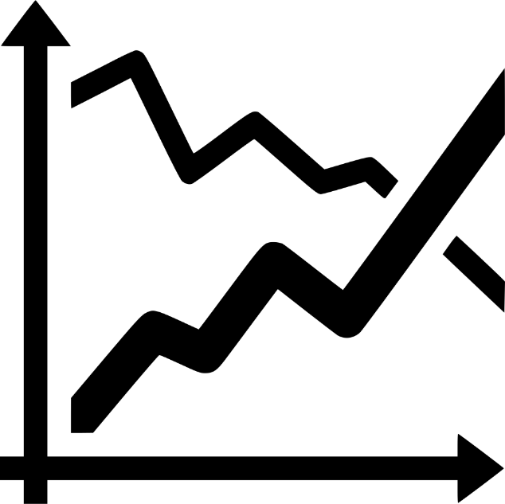

DATA EXPLORATION
Data collected from 1994
Important features: Gender, Age, Native Country, Education, Occupation, Marital Status
Determine if a person earns over $50K or $50K or less annually.
Gender and Occupation have significant impacts on income levels.

Slide 5

WARM-UP QUIZ

Slide 6
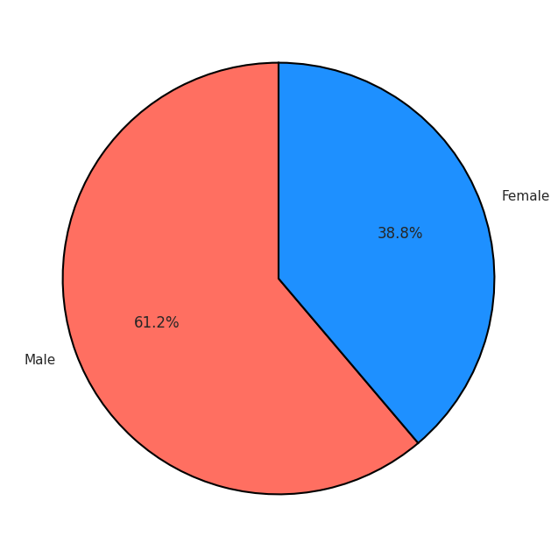
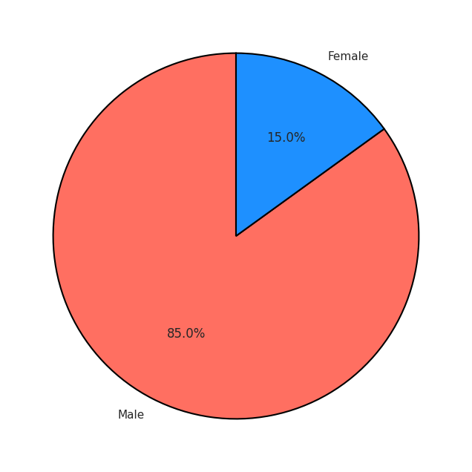
INCOME
Low-Income (<=50K)
distribution by Gender
High-Income (>50K)
distribution by Gender

Slide 7
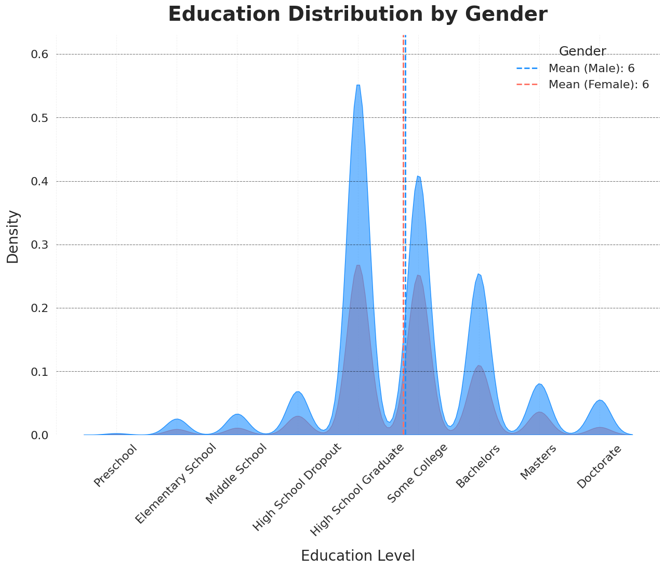
EDUCATION
Income higher than 50K annually

Slide 8
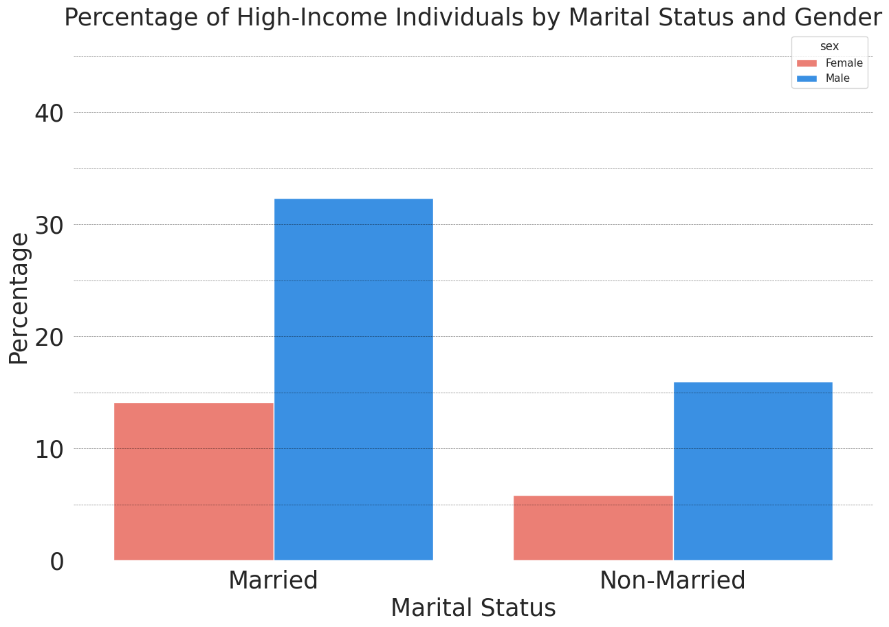
MARITAL STATUS
Percentage of high-income
individuals by marital status
and gender

Slide 9
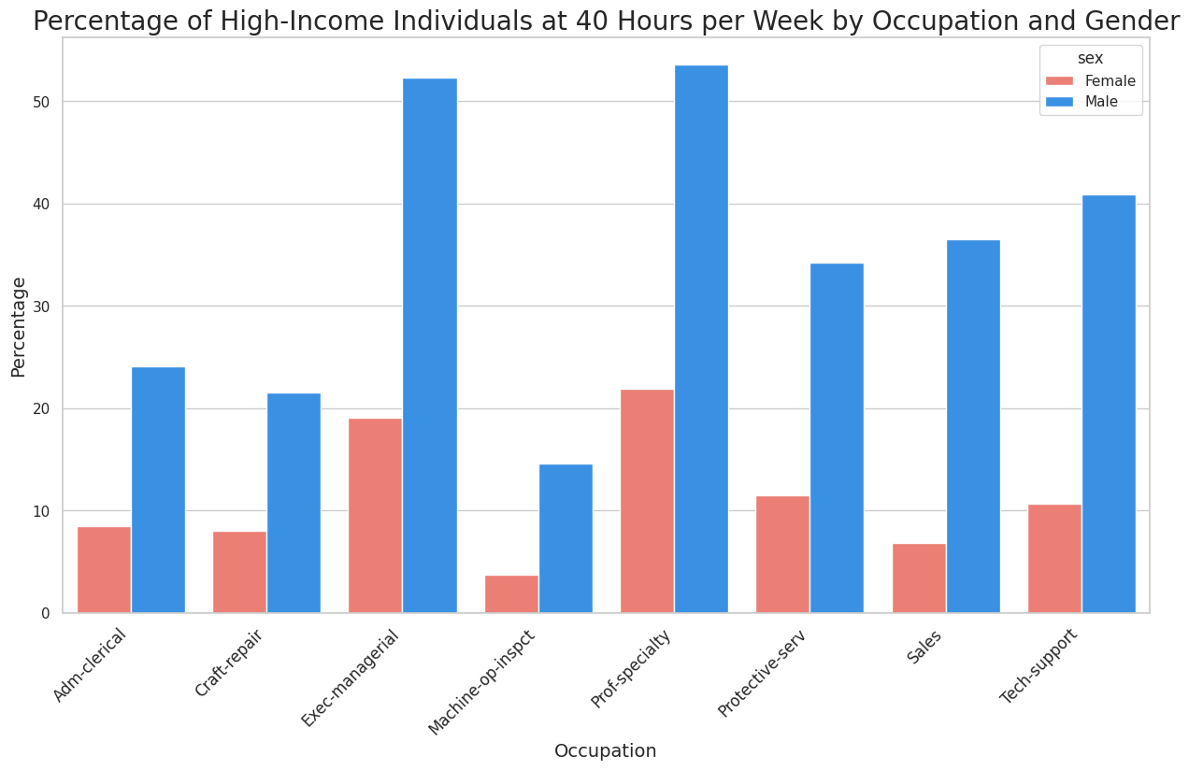
OCCUPATION
Percentage of high-income individuals at
40 hours per week by occupation and gender

Slide 10

CONCLUSION
Across all industries, women’s earnings are lower than those of men.
As education levels increase, the income gap narrows.
Marriage plays a significant role in women’s economic dependence.

Slide 11

QUESTIONS?

